Slide 1

COMP2001 Non-relational databases
Martin Read

Slide 2
Session outline
To introduce landscape for advanced database concepts and information retrieval
Summarise major approaches of the NoSQL data model and how they differ from the relational model

Slide 3
Databases
“A database is a collection of information that exists over a long period of time, often many years. ”
– Garcia-Molina et al. Database Systems: The Complete Book
Databases are powerful tools for doing exactly what computers do best:
store
manipulate
display
information

Slide 4
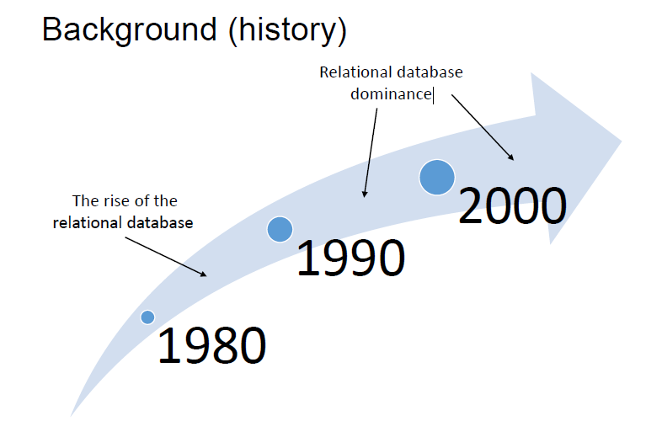

Slide 5
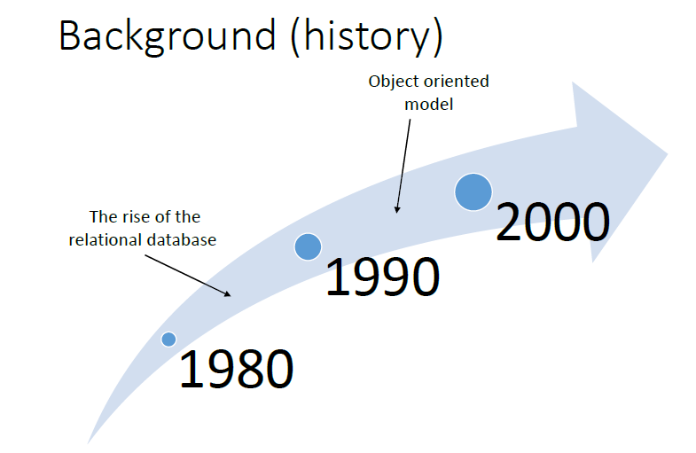

Slide 6
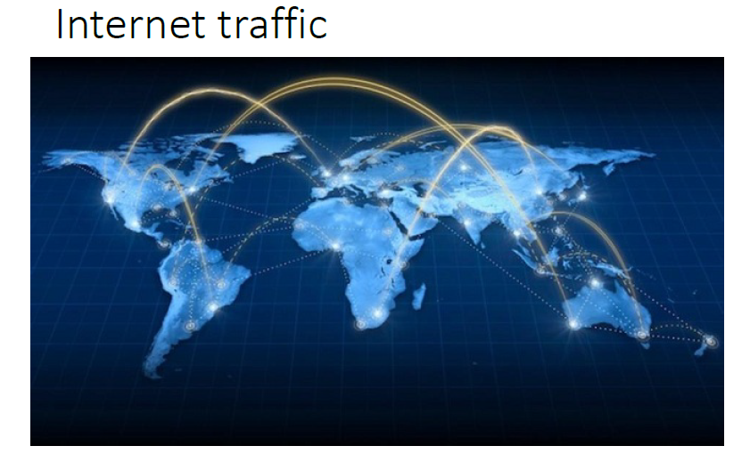

Slide 7
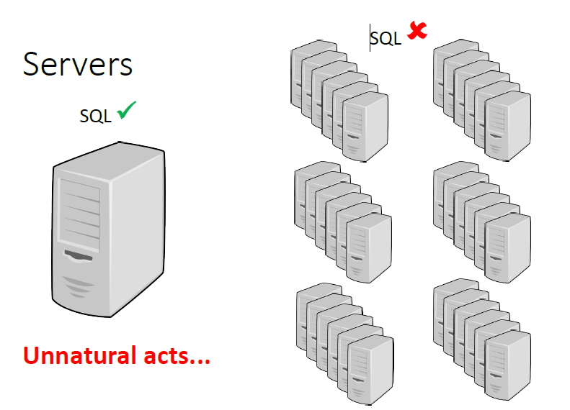

Slide 8
New data storage systems

Slide 9
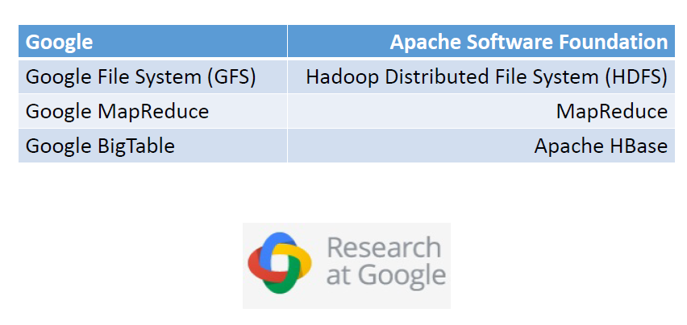
Origins

Slide 10
Google whitepapers
The origins of non-relational databases can be traced back to 3 Google whitepapers:
Sanjay Ghemawat, Howard Gobioff, and Shun-TakLeung. 2003. The Google file system. In Proceedings of the 19th ACM symposium on Operating systems principles(SOSP '03). ACM, New York, NY, 29-43.
Jeffrey Dean and Sanjay Ghemawat. 2010. MapReduce: A flexible data processing tool.Commun. ACM53, 72-77.
Fay Chang, et al. 2008. Bigtable: A Distributed Storage System for Structured Data. ACM Trans. Comput. Syst.26, 2

Slide 11
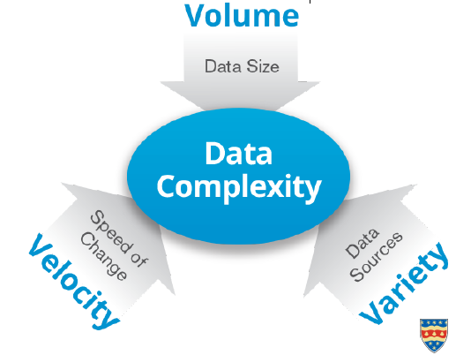
Big Data
Big data is often described using the three Vs: volume, velocity and variety

Slide 12
Four Vs
Sometimes big data is described using four Vs:
Volume
Velocity
Variety
Veracity

Slide 13
Veracity
Refers to the messiness or trustworthiness of the data
With many forms of big data, quality and accuracy are less controllable
Estimated that poor data quality costs the US economy 3.1 trillion US dollars per year
consider Twitter posts, abbreviations, typos & colloquial speech
reliability and accuracy of content
technology now allows us to work with this type of data

Slide 14
Five Vs
Sometimes big data is described using five Vs:
Volume
Velocity
Variety
Veracity
Value

Slide 15
Value
Value refers to the ability to achieve greater value through insights from the analysis of big data
Aircraft engine manufacturers make use of big data analysis to predict engine events that lead to costly airline disruptions with 97% accuracy. This could save millions

Slide 16
Criticism
Big data is an ill-defined term
There is a lack of precision in the definition of big data, which leads to ambiguity
NoSQL is an accidental neologism
a term with no prescriptive definition. All you can make is an observation of common characteristics

Slide 17
New data storage systems

Slide 18
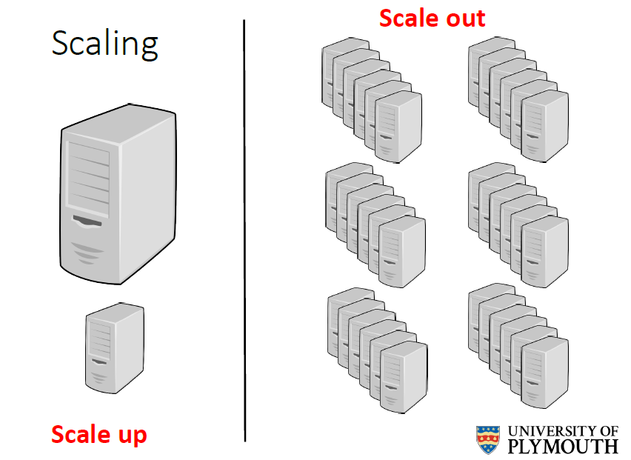

Slide 19
Emerging data models
Bigtable: Google Bigtable
Key-value store, or key-value database: Redis, MemcacheDB, Berkeley DB (BDB), HamsterDB...
Document-oriented database, or document store: MongoDB, CouchDB, OrientDB, RavenDB, Lotus Notes....
Graph database: Neo4j, HyperGraphDB...

Slide 20
NoSQL... ?
NoSQL was a Twitter hashtag (#nosql) chosen for a meetup organised by Johan Oskarssonin San Francisco in 2009 to discuss new databases
“NoSQL is an accidental term with no precise definition”. [Sadalage& Fowler: NoSQL Distilled, 2012]

Slide 21
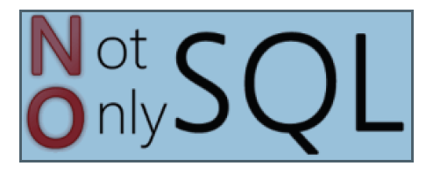
NoSQL
NoSQLmeans Not Only SQL
implying that when designing a software solution or product, there is more than one storage mechanism that could be used

Slide 22
NoSQL features
Non-relational
Cluster friendly
Open source
21st Century Web

Slide 23
Key-value store
Key-value pairs are similar to a table
key serves as an index to find an associated value
Key-value pairs are similar to accessing data in memory
the key is a memory location & the value is the data stored at the location, making key-value pairs a good data model for in-memory databases

Slide 24

Any Questions?

